Slide 1
Mary McLeod Bethune
An Act of Human Kindness

Slide 2
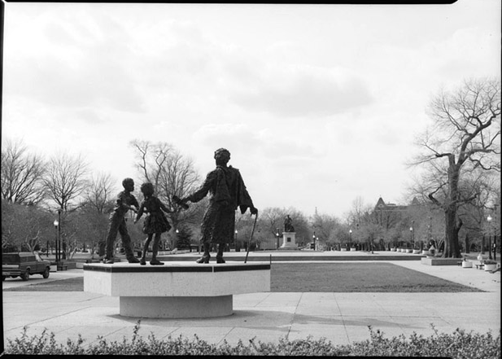
Statement
Today a statue of Mary McLeod Bethune stands in Lincoln Park, Washington, D.C., not far from the U.S. Capitol
"For I am my mother's daughter, and the drums of Africa still beat in my heart. They will not let me rest while there is a single Negro boy or girl without a chance to prove his worth it" - Mary McLeod Bethune

Slide 3
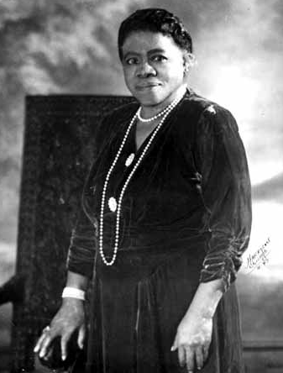
Introduction
Education today
Struggles
Mary McLeod Bethune
Achievements made by her

Slide 4
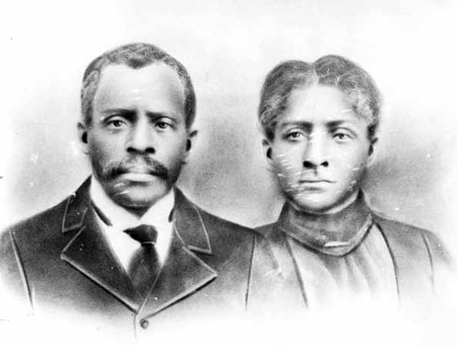
History
Personal Background
Her last gift
Education and Creating Her Dreams

Slide 5
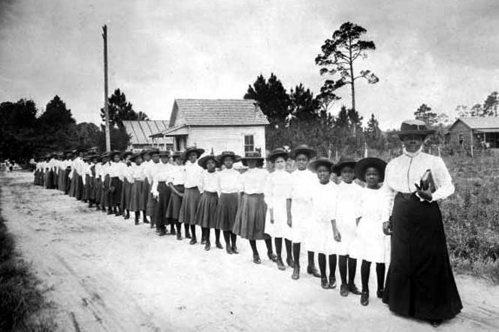
Purpose
Education
Racial Equality
Have we continued Mary’s Purpose

Slide 6
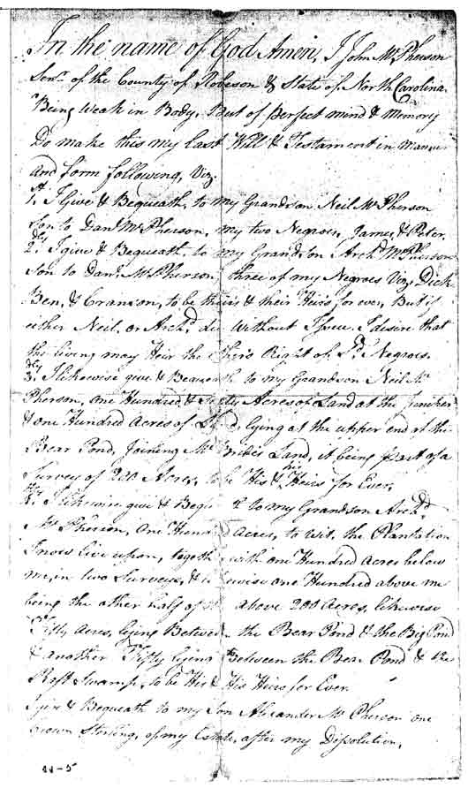
Argument
Last will and Testament
Introducing racial equality
Areas Bethune worked in…
Raise awareness

Slide 7
1st Relation
Challenges
Relating The President- Bethune && Life today
For the future….
-Fabby

Slide 8
2nd Relation
Persistence
Impact left on our generation because of Bethune
Making a change through education
-Alma

Slide 9
3rd Relation
How Bethune made a difference for my culture
Bethune’s quote
What’s possible because of her
-Maddy

Slide 10
4th Relation
Youth today
Negative role Models
-Jacob

Slide 11
Final Relation
Take Mary McLeod Bethune as a role model
My goals
We can make a difference
-Raquel

Slide 12
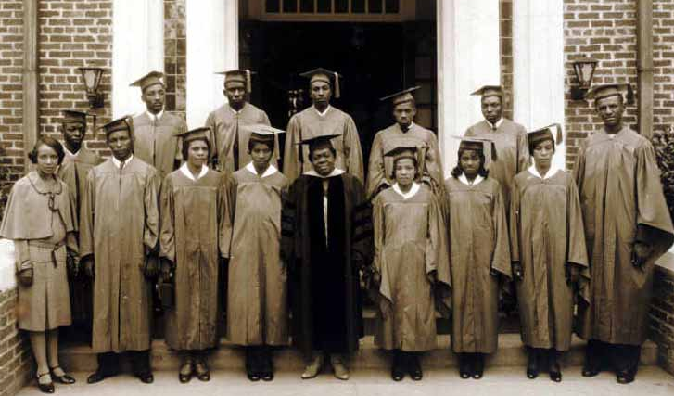
Conclusion
Extraordinary Example of a Master Student
What motivated her, what motivates you
Mary McLeod Bethune, college graduate

Slide 13
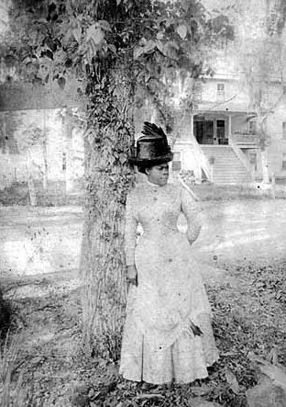
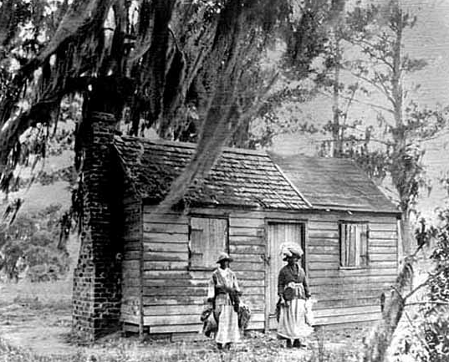
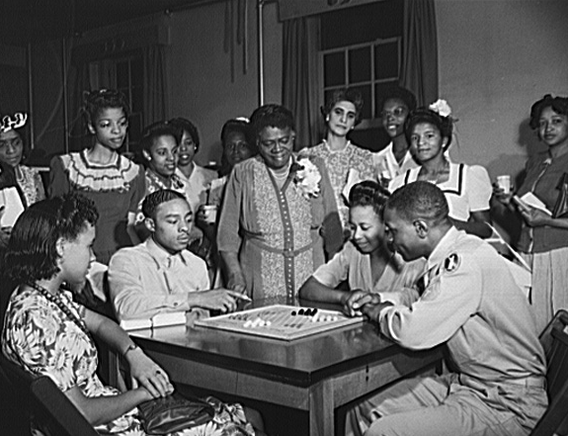
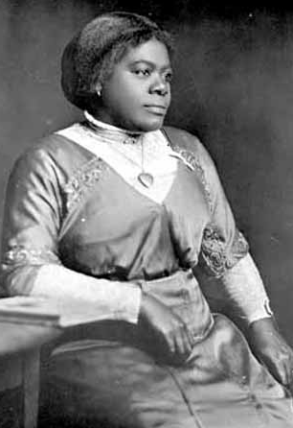
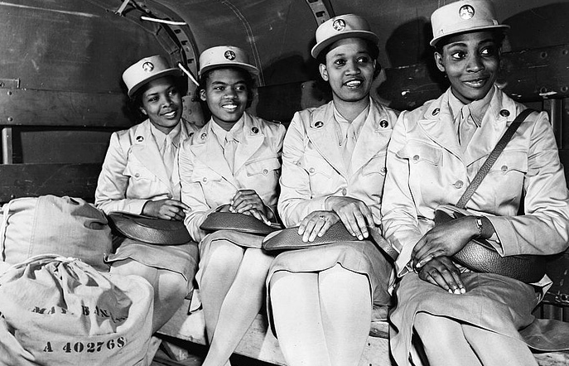
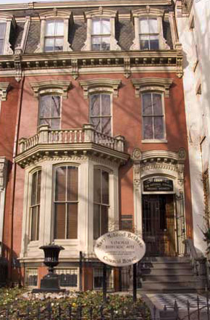
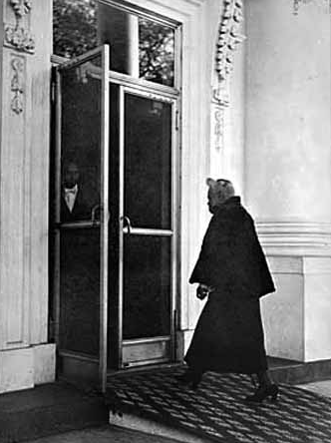
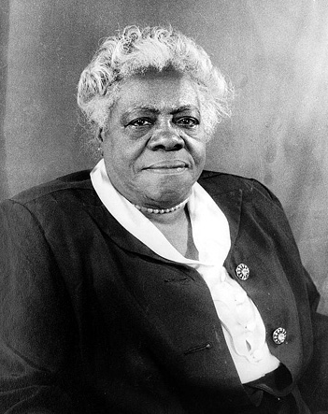

Slide 14
References
Google. (1995) Mary McLeod Bethune. Pictures Retrieved November 15, 2010.
Asantem Molefi Kete (2002). 100 Greatest African Americans: A Biographical Encyclopedia. Amherst, New York. Prometheus Books.
Owens Peare (1951). Mary McLeod Bethune. Canada: Copp Clark Company
Greene, C. (1993). Mary Mcleod Bethune. Capstone Press.
Smith, Elaine M. “Bethune, Mary McLeod” in Black Women in America: An Historical Encyclopedia (Brooklyn, N.Y.:Carlson Publishing Co., 1993), 113-127.
Sterne, Emma Gelders. Mary McLeod Bethune. (New York: Alfred A. Knopf, Inc., 1957).

