Slide 1
TEENAGE RELATIONSHIPS
By: Alma Mulabegovic, Doruntina Collaku && Emily Norell

Slide 2
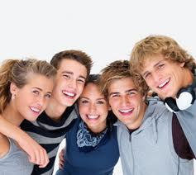



THE DIFFERENT TYPES
FAMILY
FRIENDSHIPS
PROFESSIONAL
ROMANTIC

Slide 3

ROMANTIC RELATIONSHIPS
Romantic relationships are often conceptualized as friendships marked by passion, commitment and intimacy.

Slide 4
Building a Romantic Relationship
PICK MATE
INTRODUCE (SMALL TALK)
BECOME FRIENDS
START DATING
TALK ABOUT WHERE YOU STAND WITH EACHOTHER
STAY FRIENDS OR START A RELATIONSHIP
BE SURE TO COMMUNICATE WANTS/NEEDS WITH EACHOTHER
LONG TERM OR BREAK UP
KEEP COMMUNICATING AND FOCUSING ON CHANGES IN THE RELATIONSHIP (ARE YOU COMPTAIBLE ?)
MAKE A BIGGER COMMITENT OR END IT

Slide 5
Give a relationship time and care to develop:
Learning to give or receive
Revealing feelings
Listening and supporting
YES,
YOU WILL HAVE TO “TALK ABOUT IT”

Slide 6

The potion for love
Combined in different ways to make different kinds of relationships:
Closeness w/out Attraction = Best friends
Attraction w/out Closeness= Crush/ infatuation
Attraction + Closeness= Romantic Love
w/out all 3 = professional/ casual
1. Attraction
2.Closeness
3.Commitment

Slide 7
Relationship Compatibility
THE
TO A HEALTHY HAPPY RELATIONSHIP

Slide 8

EMOTIONAL INTELLIGENCE
Before you give yourself to another person you have to make sure you’re emotionally stable for the relationship.
TIMING IS EVERYTHING!

Slide 9
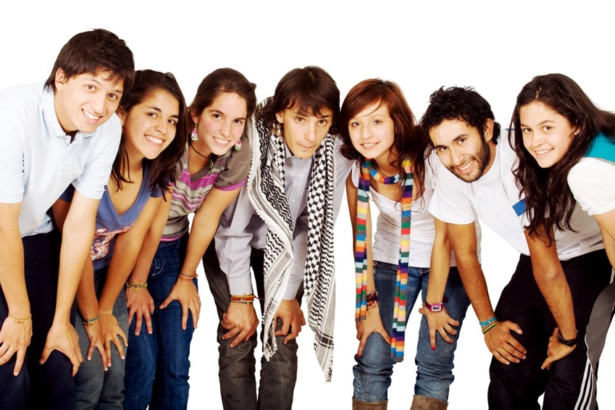
PEER RELATIONSHIPS
Peer relationship is defined as: a friendship relationship based on mutual respect, appreciation, and liking.

Slide 10

SEXUAL HARRASMENT
WHAT IS SEXUAL HARRASMENT?
Sexual harassment in schools is unwanted and unwelcome behavior of a sexual nature that interferes with the right to receive an equal educational opportunity

Slide 11
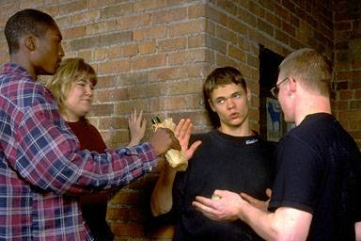
PEER PRESSURE
In a survey of 4239 teens nationwide, were asked:
“What do you think is the biggest influence to try drugs?”
59% responded peer pressure
32% responded stress and problems
8% responded examples from movies, music and the media.

Slide 12
BROKEN RECORD METHOD
KEN: Do you want to smoke a joint?
SAM: I don't do drugs.
KEN: Just try it. It's not a big deal.
SAM: I don't do drugs.
KEN: What are you, a wuss? Don't be such a baby.
SAM: I don't do drugs.
KEN: Is that all you can say?
SAM: I don't do drugs.

Slide 13

FAMILY RELTIONSHIPS
Communicat-ion issues are at the heart of healthy and successful family dynamics.

Slide 14
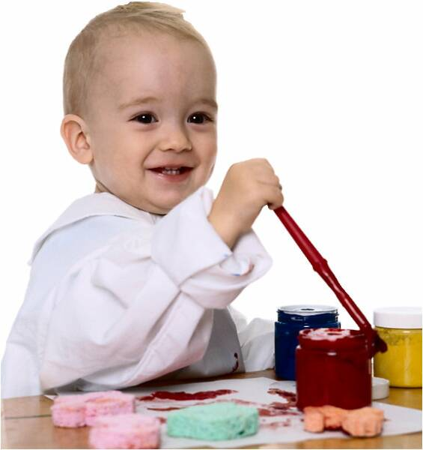


AS THEY GROW UP (stages)

Slide 15
COMMUNICATION
Communication is the primary indicator of the quality of the adolescent–parent relationship”
Open Communication
Healthy Relationships
Strengthen Relationships

Slide 16
RULES
Rules change drastically during adolescence and teens.
7 Rules of Parenting
  What You Do Matters
  You Can’t Be Too Loving
  Stay Involved
  Adapt Your Parenting
  Set Limits
  Foster Independence
  Explain Your Decisions

Slide 17

PROFESSIONAL RELATIONSHIPS
We spend a large portion of our day at work. In today's information and service centered economies, success in your career will be greatly affected by your abilities to relate to others interpersonally.

